Slide 1
Sequential Circuits Basics
Reference: www.electronicshub.org

Slide 2
Sequential logic circuits
Sequential logic circuits are those, whose output depends not only on the present value of the input but also on previous values of the input signal (history of values).
Example:
To count the number of audience entering or leaving an auditorium or to count number of vehicles in parking. In this when any person enters in to auditorium the counter increments its value depending on its present value. Similarly, it decrements its value depending on its previous and present value. So Counter retains the present state of the counter to do next operation.

Slide 3
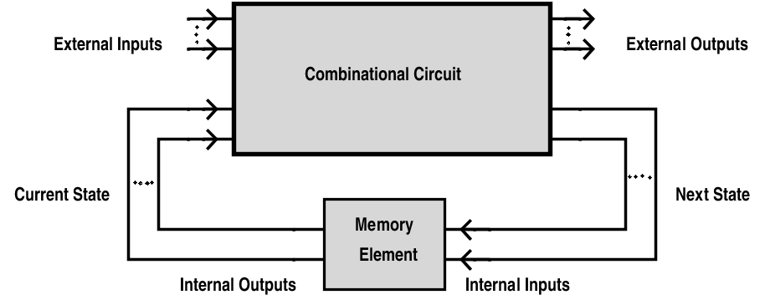

Slide 4
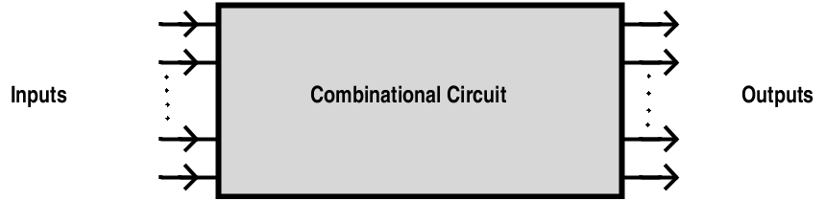
Combinational Logic Circuit
In combinational circuits output depends only on the present values of the input.

Slide 5
Combinational circuits vs Sequential circuits
COMBINATIONAL CIRCUITS | SEQUENTIAL CIRCUITS
Output depends only on the present value of the inputs. | Output depends on both the present and previous state values of the inputs
These circuits will not have any memory as their outputs change with the change in the input value. | Sequential circuits have some sort of memory as their output changes according to the previous and present values.
There are no feedbacks involved. | In a sequential circuit the outputs are connected to it as a feedback path.
Used in basic Boolean operations. | Used in the designing of memory devices.
Implemented in: Half adder circuit, full adder circuit, multiplexers, demultiplexers, decoders and encoders. | Implemented in: RAM, Registers, counters and other state retaining machines.

Slide 6
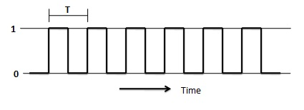
Clock Signal
A clock is a signal, which oscillates between logic level 0 and logic level 1, repeatedly. Square wave with constant frequency is the most common form of clock signal. A clock signal has “edges”. These are the instants at which the clock changes from 0 to 1 (a positive edge) or from 1 to 0 (a negative edge).

Slide 7
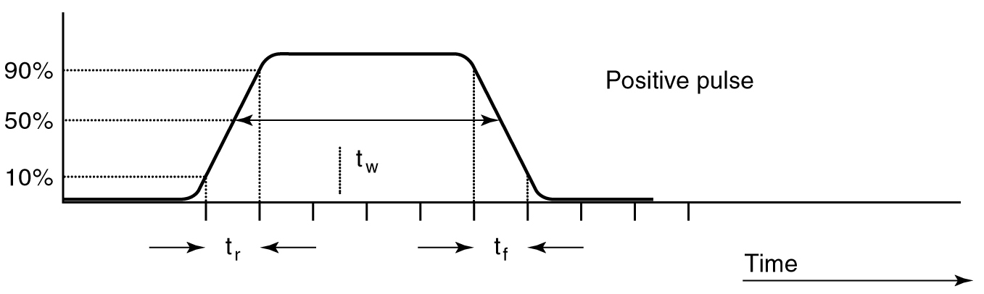
Signals that switch between active and inactive states are called pulse waveforms.
A positive pulse has an active-HIGH level.

Slide 8
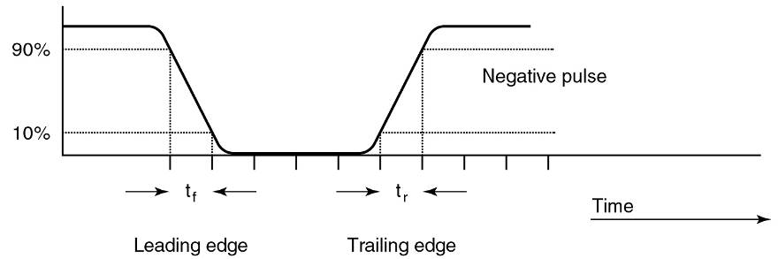
Signals that switch between active and inactive states are called pulse waveforms.
A negative pulse has an active-LOW level.

Slide 9
In actual circuits it takes time for a pulse waveform to change from one level to the other.
Transition from LOW to HIGH on a positive pulse is called rise time (t_{r}).
Measured between the 10% and 90% points on the leading edge of the voltage waveform.

Slide 10
In actual circuits it takes time for a pulse waveform to change from one level to the other.
Transition from HIGH to LOW on a positive pulse is called fall time (t_{f}).
Measured between the 90% and 10% points on the trailing edge of the voltage waveform.

Slide 11
In actual circuits it takes time for a pulse waveform to change from one level to the other.
A pulse also has a duration—width—(t_{w}).
The time between the points when the leading and trailing edges are at 50% of the HIGH level voltage.

Slide 12
Triggering
Definition The change in output of a flip flop can be done by bringing a small change in the input signal. This small change can be done with the help of a clock pulse. This clock pulse is known as a Trigger pulse.

Slide 13
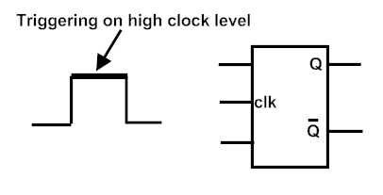
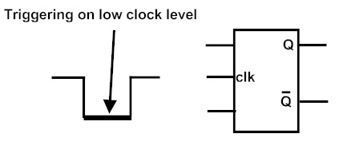
Level Triggering
The triggering process in which the change in the output state is according to the active level of inputs is called “Level Triggering”.
Level triggering is of two types, they are
1. High level triggering.
2. Low level triggering.

Slide 14
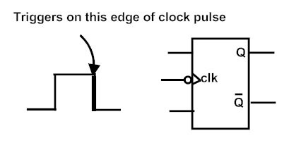
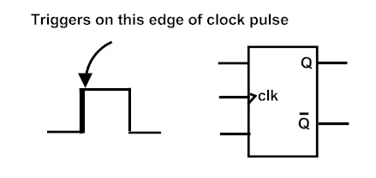
Edge Triggering
In Edge Triggering, the output changes only when the inputs are present at either of the transitions of the clock pulse i.e. either from low to high (0 to 1) or from high to low (1 to 0).
Edge triggering is of two types, they are
1. Positive edge triggering.
2. Negative edge triggering.

Slide 15
Classification of sequential circuits
Based on the clock signal input, the sequential circuits are classified into two types.
Synchronous sequential circuit
Asynchronous sequential circuit

Slide 16
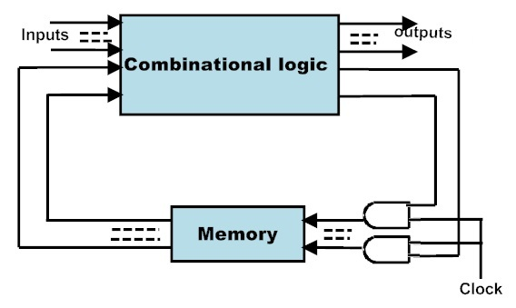
Synchronous sequential circuit
In Synchronous sequential circuit, the output depends on present and previous states of the inputs at the clocked instances. The circuits use a memory element to store the previous state. The memory elements in these circuits will have clocks. All these clock signals are driven by the same clock signal

Slide 17
Using clock signal, state changes will occur across all storage elements.
These circuits are bit slower compared to asynchronous because they wait for the next clock pulse to arrive to perform the next operation.
These circuits can be clocked or pulsed.
The Synchronous sequential circuits that use clock pulses in their inputs are called clocked-sequential circuits. They are very stable.

Slide 18
Where we use synchronous sequential circuits??
Used in the design of MOORE-MEALY state management machines.
They are used in synchronous counters, flip flops etc.

Slide 19
Limitations of Synchronous Sequential Circuits
All the flip – flops in synchronous sequential circuits must be connected to clock signal. Clock signals are very high frequency signals and clock distribution consumes and dissipated a large amount of heat.
Critical path or the slowest path determines the maximum possible clock frequency. Hence they are slower than asynchronous circuits.

Slide 20
Asynchronous Sequential circuits
The Sequential circuits which do not operate by clock signals are called “Asynchronous sequential circuits”.
These circuits will change their state immediately when there is a change in the input signal .
The Circuit behavior is determined by signals at any instant in time and the order in which input signals change.
They do not operate in pulse mode.
They have better performance but hard to design due to timing problems.
Mostly we use the asynchronous circuits when we require the low power operations.
They are faster than synchronous sequential circuits as they do not need to wait for any clock signal.

Slide 21
Where we use Asynchronous sequential circuits??
These are used when speed of operation is important. As they are independent of internal clock pulse, they are operate quickly. so they are used in Quick response circuits.
Used in the communication between two units having their own independent clocks.
Used when we require the better external input handling.

Slide 22
Limitations/drawbacks
Asynchronous sequential circuits are more difficult to design.
Though they have a faster performance, their output is uncertain.

